Slide 1
IT in a Supply Chain
Information is crucial to the performance of supply chain because it provides the basis on which supply managers make decisions.
Information Technology consists of the tools used to gain awareness of information, analyze the information and execute on it to increase the performance of the supply chain.

Slide 2
Information is a key supply chain driver because it serves as the glue that allows other drivers
Managers must understand how information is gathered and analyzed. This is where IT comes into play as IT consists of the hardware, software and people throughout a SC that gather, analyze and execute upon information.
Thus, the organization needs to be connected and become able to share information in real time and instantaneously. This is not achievable without IT and the tools it offers for organization wide collaboration.

Slide 3
Role of IT in a Supply Chain Management:
Information provides the foundation on which supply chain processes execute transaction and managers make decisions
Hardware, software, and people throughout the supply chain that gather, analyze and execute upon information
1. Information must be accurate
2. Information must be accessible in a timely manner
3. Information must be of the right kind
4. Information must be shared

Slide 4
Information is used when making decision about
Facility
Inventory
Transportation
Sourcing
Pricing and revenue Management

Slide 5
The supply chain IT Framework:
Provides access and reporting of support chain transaction data
Advanced system layer a level of analytics that uses transaction data to proactively improve supply chain performance
Enterprise software forms that foundation of a supply chain IT system

Slide 6
The supply chain Macro Processes
Customer Relationship Management ( CRM)
Internal Supply chain Management ( ISCM)
Suppliers Relationship Management ( SRM)
Transaction Management Foundation (TMF), basic enterprise resource Planning
When enterprise performance is closely linked supply chain performance, firms must focus on macro processes

Slide 7
Customer Relationship Management:
Customer relationship management (CRM)systems, sometimes called e-CRM systems, use technology to help an e-business manage its customer base .
CRM allows an e-business to match customer needs with product plans and offerings, remind customers of service requirements, and determine what products a customer has purchased .
The Processes that take place between an enterprise and its customers downstream in the supply chain
Marketing
Sell
Order management
Call/ service center

Slide 8
Internal Supply Chain Management:
Strategic Planning
Demand planning
Supply planning
Fulfillment
Field service
There must be strong integration between the ISCM and CRM macro Processes

Slide 9
Suppliers Relationship Management
Design collaboration
Source
Negotiate
Buy
Supply collaboration
There is a natural fit between ISCM and SRM processes

Slide 10
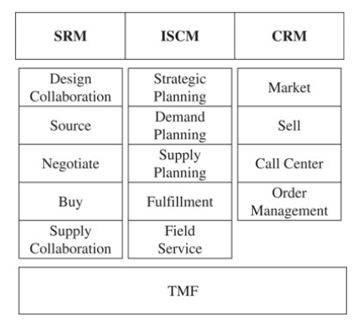
Suppliers Relationship Management

Slide 11
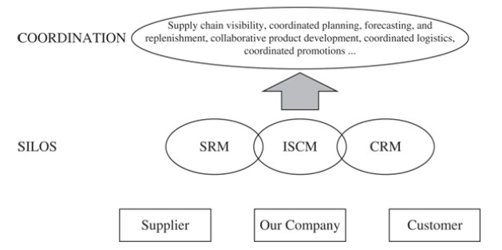
The Transaction Management Foundation
Early ERP system focused on transaction management and process automation
Current focus on improving decision making in the three macro processes

Slide 12
The Future of IT in the Supply Chain
The three SCM macro processes will continue to drive the evolution of enterprise software
Three important trends
The growth in software as a service
Increase availability of real-life data
Increase use of mobile technology

Slide 13
Risk Management in IT:
IT risk management — also called information security risk management — consists of the policies, procedures, and technologies that a company uses to mitigate threats from malicious (bad) actors and reduce information technology vulnerabilities(attack) that negatively impact data confidentiality, integrity, and availability.
Why is IT risk management important?
By identifying and analyzing potential vulnerabilities with an enterprise IT network, organizations can better prepare for cyber attacks and work to minimize the impact of a cyber incident, should it occur.
The procedures and policies implemented with an IT risk management program can help guide future decision-making about how to control risk while focusing on company goals.

Slide 14
Risk Management in IT
Installing new system
Revised business processes
Integration
Problems can shut down the business
Software glitches (fault)
Power outages
viruses

Slide 15
Mitigating strategies
Install new IT system in an incremental fashion
Run duplicate systems to make sure the system is performing well
Implement only the level of complexity the needed

Slide 16
Supply chain IT in Practice
Select an IT system that addresses the company's key success factors
Take incremental steps and measure value
Align the level of sophistication with the need for sophistication
Use IT system to support decision making not to make decisions
Think about the future

